Slide 1
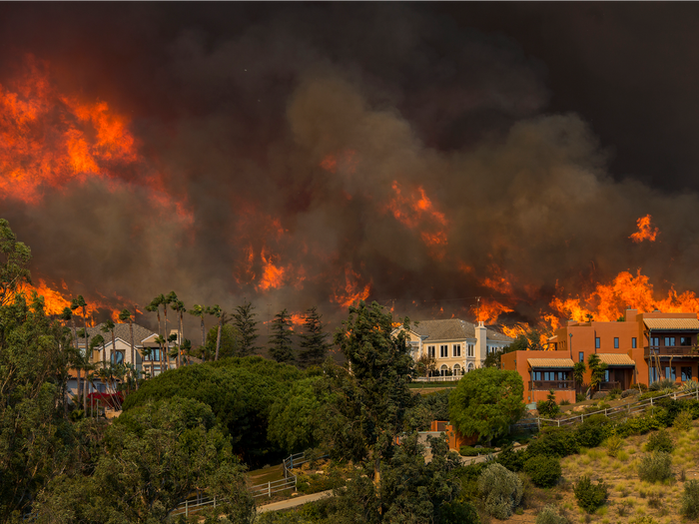
National University
ANA 699C
Wildfires: The Effects on Southern California
A Team
(Aakriti Sinha, Adam LeBlanc, Aditi Bhujbal, Anna Mkrtchyan)
Date: Nov 04, 2022

Slide 2
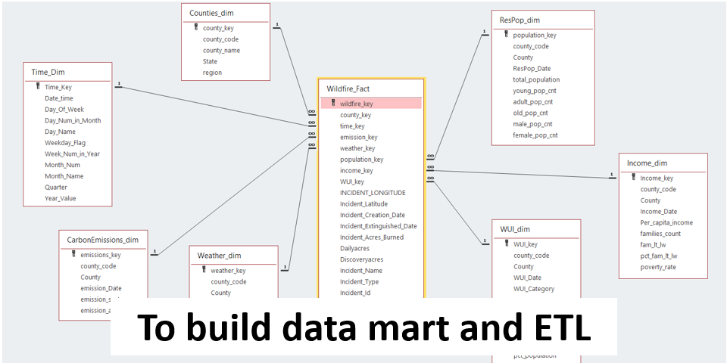
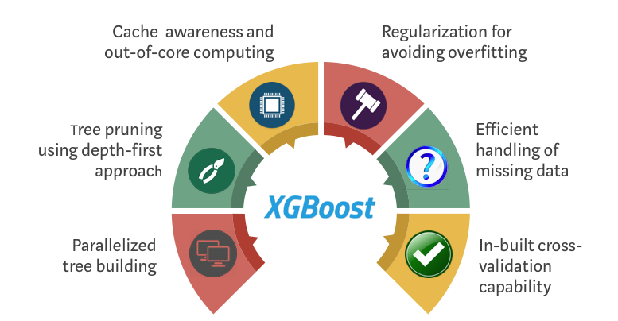


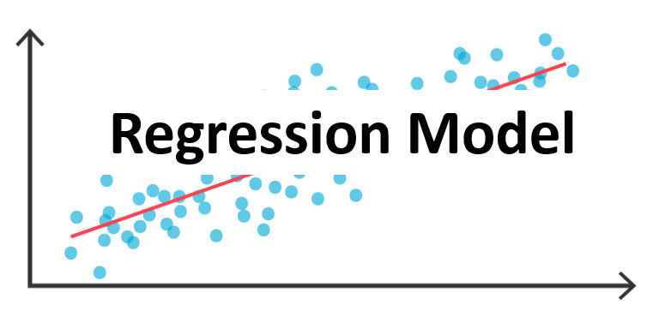

The A-team utilized various resources taught during the Course to conduct Exploratory Analysis and to create prediction model.
Aditi Bhujbal
Aakriti Sinha & Anna Mkrtchyan
Adam LeBlanc

Slide 3
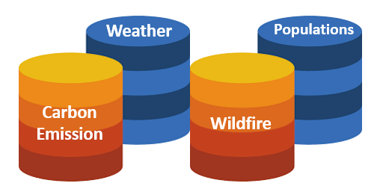
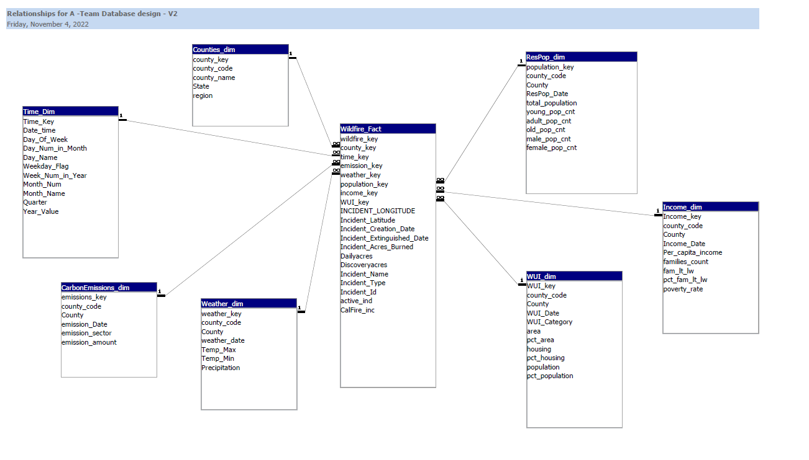

After building the data mart in Oracle DB, ETL was performed to load all the data from collected datasets into it.
ETL

Slide 4
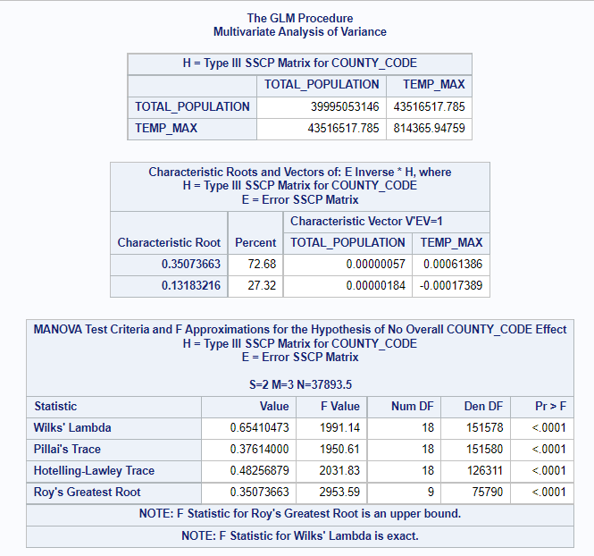
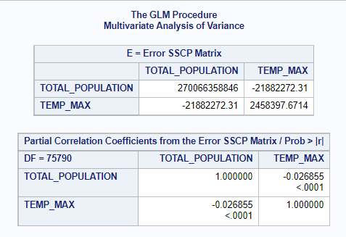
Initial exploratory analysis was performed on the combined data to verify the relationship between explanatory and outcome variables and accept/reject research hypothesis.

Slide 5

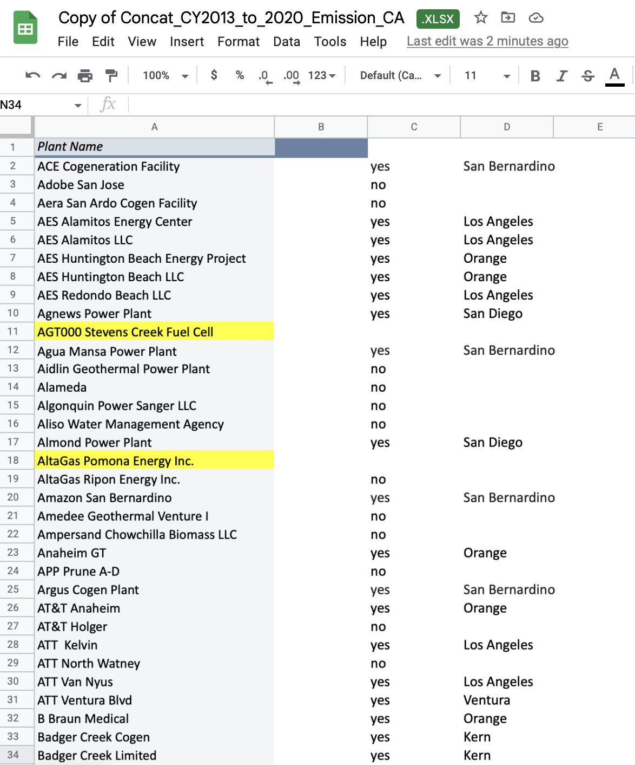



Carbon Emission data cleaning had to utilize additional methods than previously discussed.

Slide 6
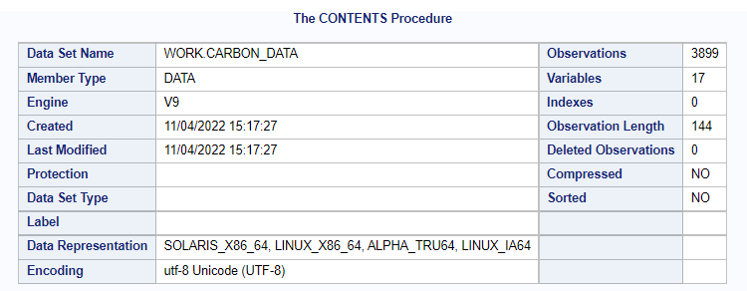
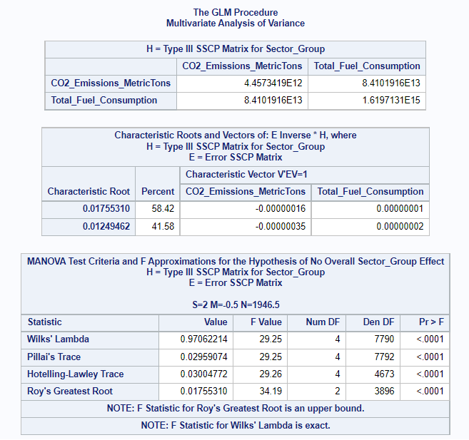
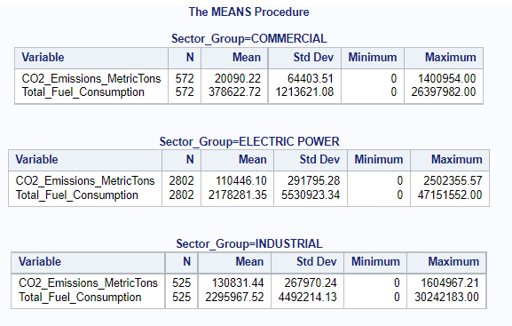
Initial exploratory analysis was performed on the merged carbon emission data (excluding county data) to verify the relationship between the explanatory and outcome variables.

Slide 7
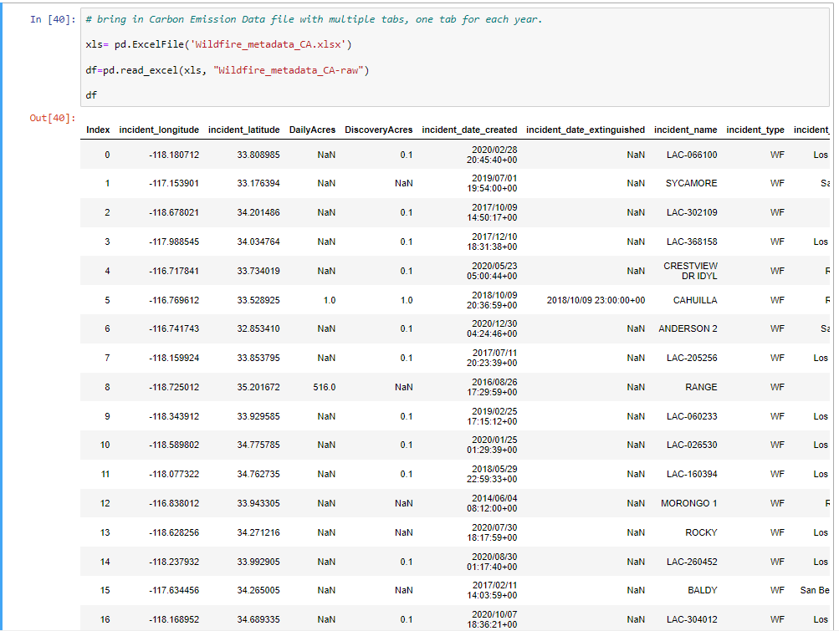


The CalFire and NIFC datasets were merged into a metadataset that contained 16 variables and 30,107 wildfire data records.

Slide 8
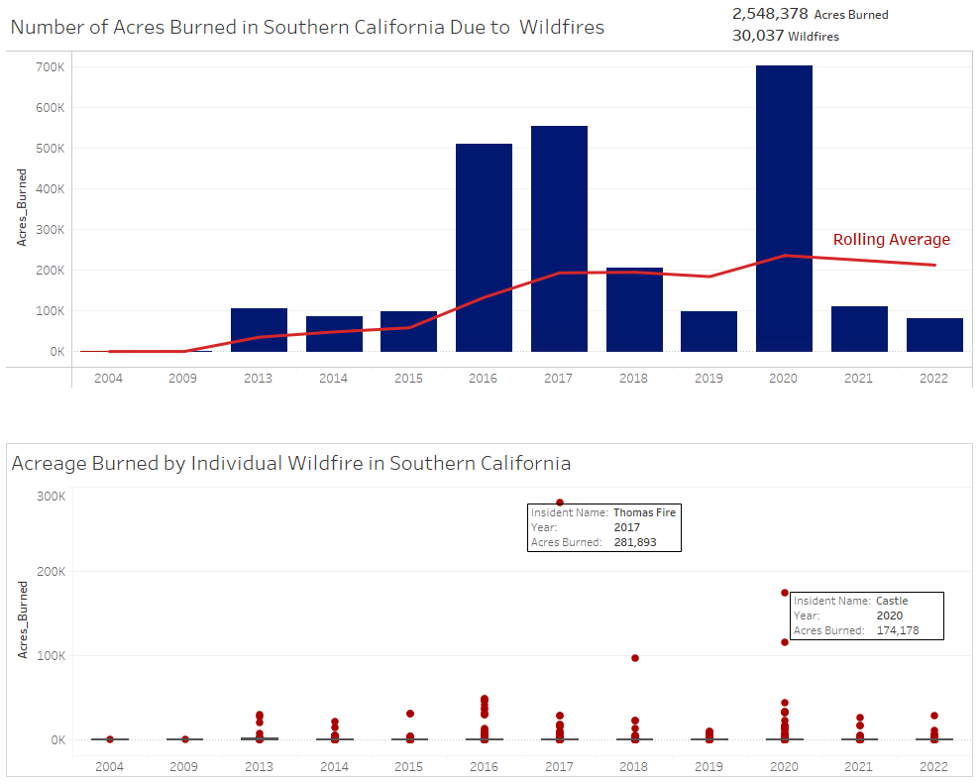

The combined Wildfire dataset was cleaned and analysed to identify wildfire frequency variance, outliers and the rolling average.

Slide 9
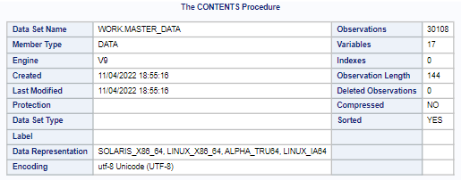
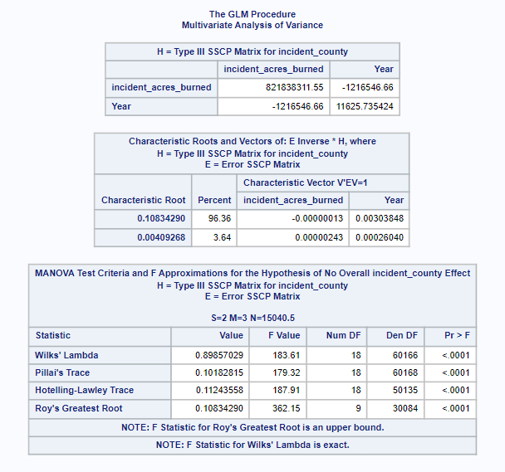
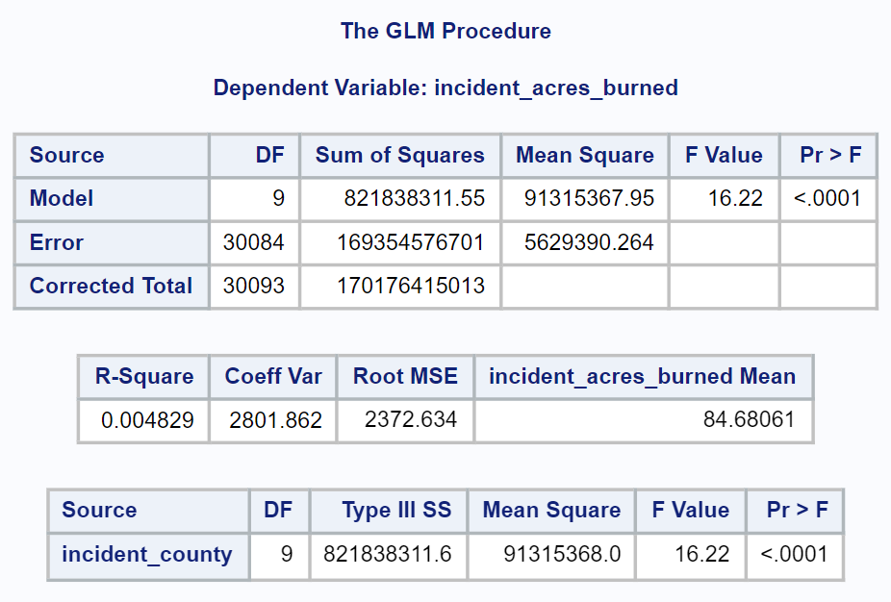
A Multivariate analysis of variance was utilized to observe the correlation between the acres burned and years.

Slide 10
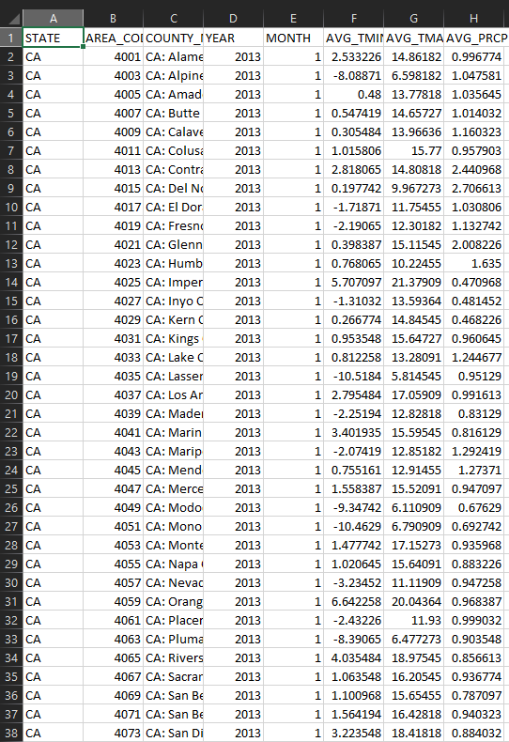

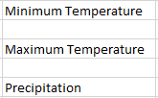

The variables selected were based on the most important aspects of temperature and limited by time.

Slide 11
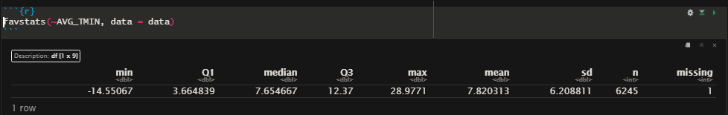
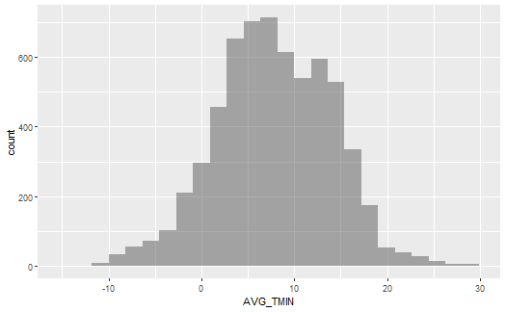
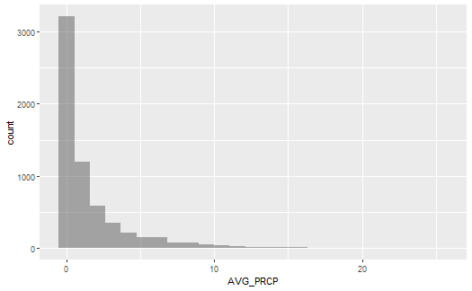
Exploratory analysis (code and results) of weather dataset for Average Minimum Temperature and Average Precipitation

Slide 12
References:
2022 Fire Season Outlook. (n.d.). Retrieved October 27, 2022, from https://www.fire.ca.gov/incidents
Kent State University (n.d.) SAS TUTORIALS: TRANSPOSING DATA USING PROC TRANSPOSE Retrieved from https://libguides.library.kent.edu/SAS/TransposeData
SAS Help Center (n.d) The GLM Procedure. Retrieved from https://documentation.sas.com/doc/en/pgmsascdc/9.4_3.3/statug/statug_glm_syntax01.htm
SAS Help Center (n.d.) CONTENTS Procedure. Retrieved from https://documentation.sas.com/doc/en/pgmsascdc/9.4_3.5/proc/n1hqa4dk5tay0an15nrys1iwr5o2.htm
SAS Help Center (n.d.) MEANS Procedure. Retrieved from https://documentation.sas.com/doc/en/pgmsascdc/9.4_3.5/proc/n1qnc9bddfvhzqn105kqitnf29cp.htm
US Carbon Monitor. Carbon monitor. (n.d.). Retrieved from https://us.carbonmonitor.org/
U.S. Energy Information Administration - EIA - independent statistics and analysis. Emissions by plant and by region. (2022). Retrieved from https://www.eia.gov/electricity/data/emissions/
WFIGS - Wildland Fire Locations Full History. (n.d.). Retrieved October 23, 2022, from https://data-nifc.opendata.arcgis.com/datasets/nifc::wfigs-wildland-fire-locations-full-history/explore?location=-0.000000,0.000000,2.37
Questions?

